Slide 1
Bridge JS DP

Slide 2
Agenda
What is Bridge?
Example
Code

Slide 3
What is Bridge?
The Bridge pattern allows two components, a client and a service, to work together with each component having its own interface.

Slide 4
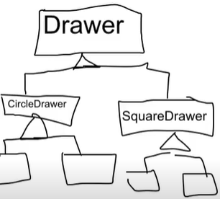
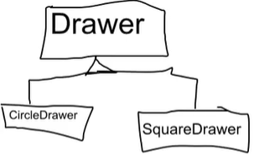
Drawer Example :

Slide 5

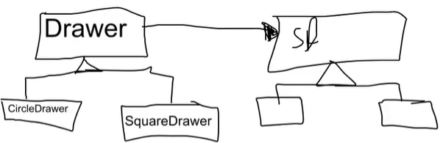

Slide 6
Input&Output TV Example :

Slide 7
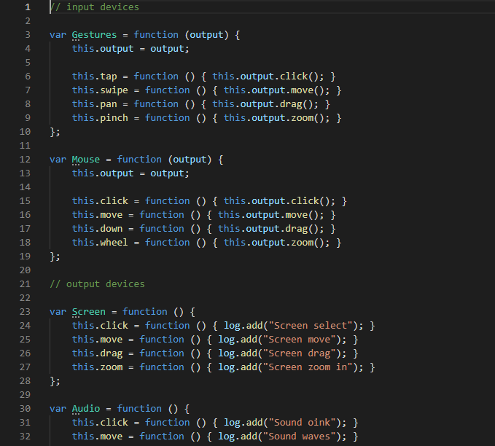

Slide 8
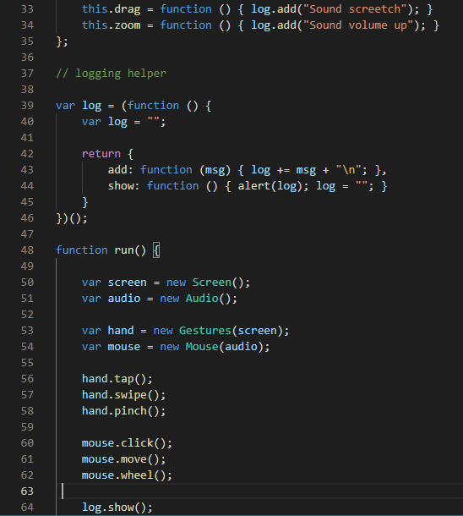

Slide 9
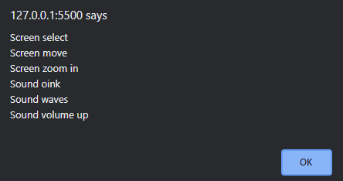

Slide 10
References :
https://www.dofactory.com/javascript/design-patterns/bridge
https://www.youtube.com/watch?v=HOKvP2rbydk
https://www.youtube.com/watch?v=9jIgSsIfh_8
https://www.codeproject.com/Articles/15665/Bridge-design-pattern-with-JavaScript
https://link.springer.com/chapter/10.1007/978-1-4302-0496-1_8

Slide 11
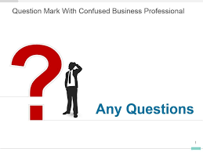
Feedback

Slide 12


